Slide 1

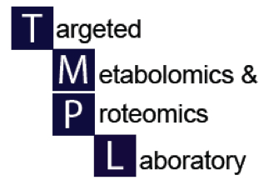

Applying MetaboAnalyst
UAB Metabolomics Workshop
December 2, 2015
Xiangqin Cui, PhD

Slide 2
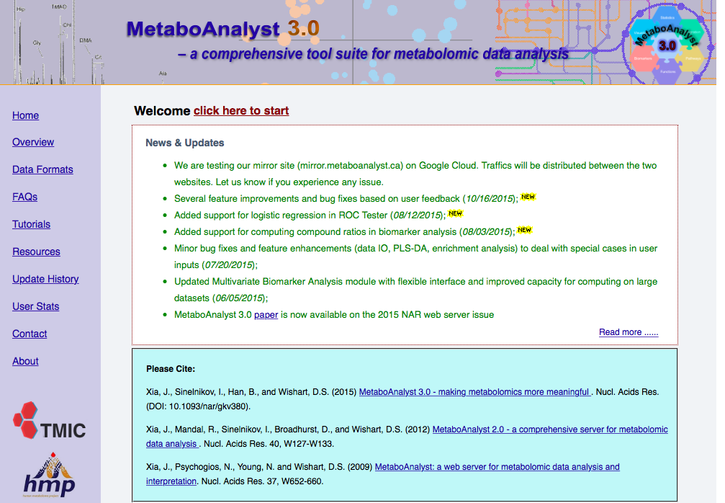

Slide 3
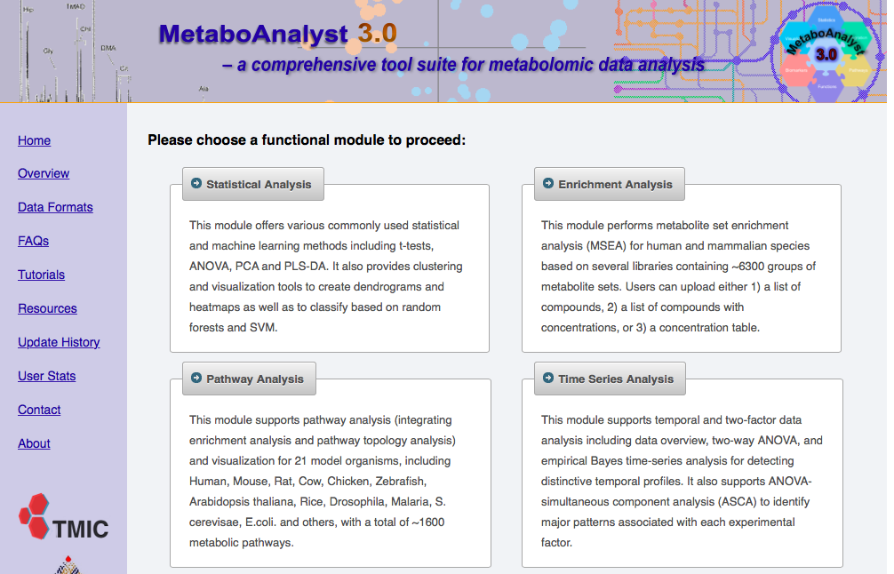

Slide 4
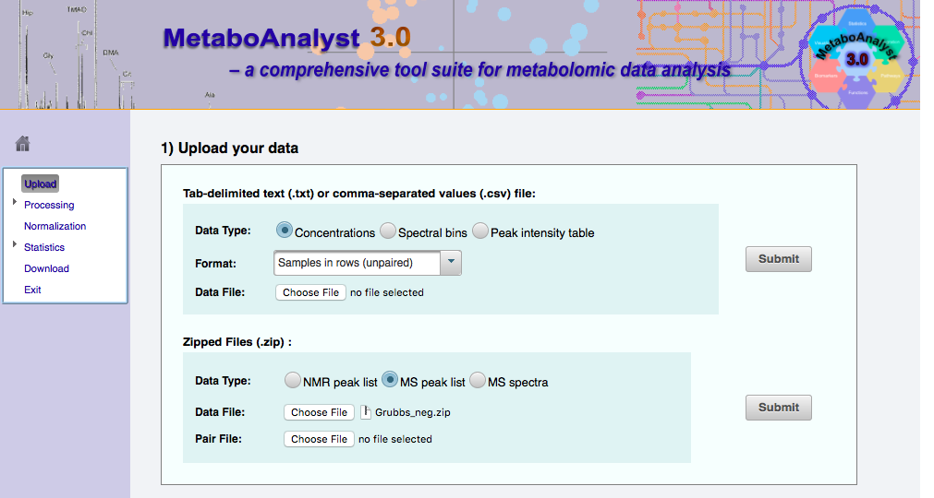
Select MS peak list option and then load the .zip file

Slide 5
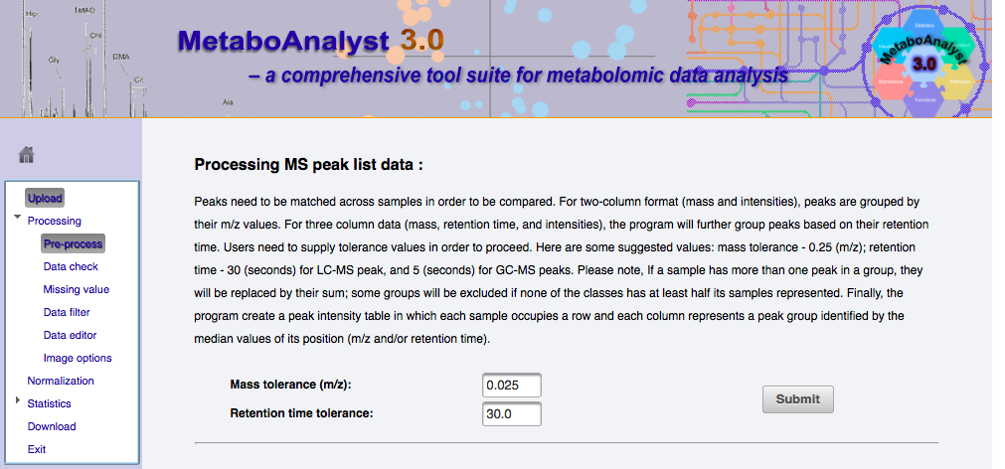

Slide 6
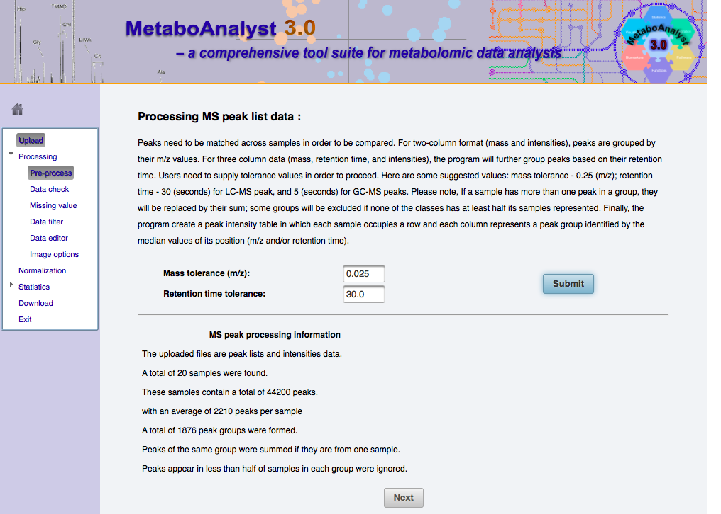

Slide 7
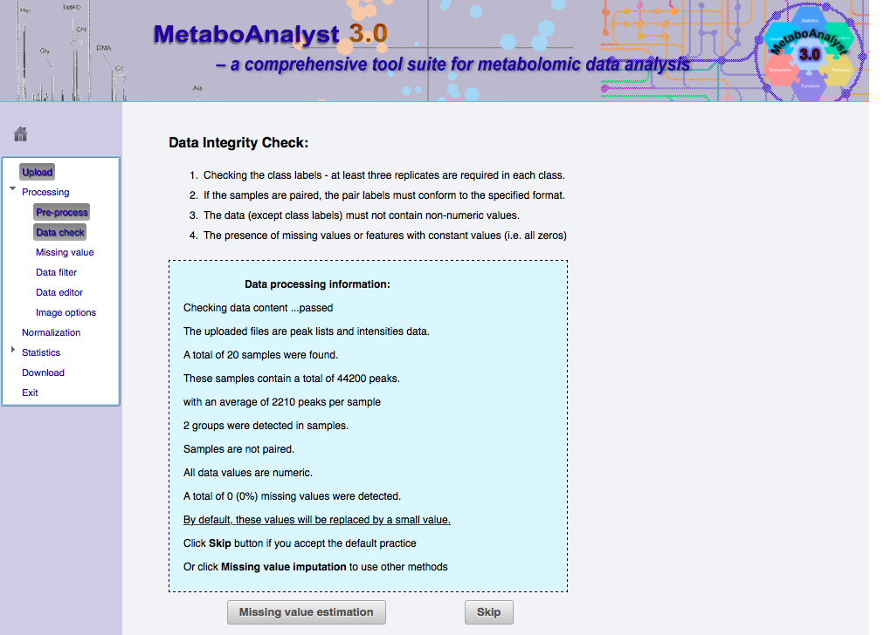

Slide 8
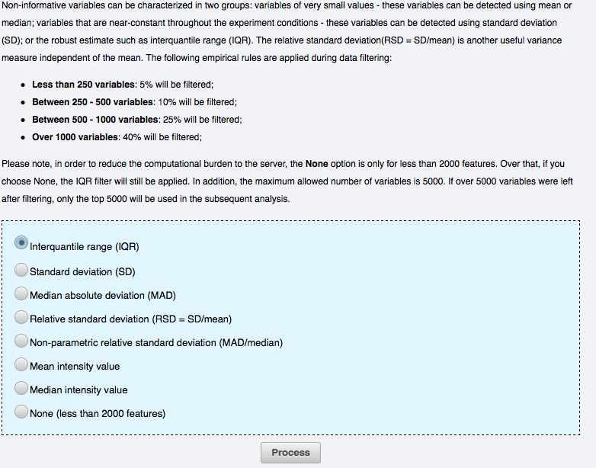

Slide 9
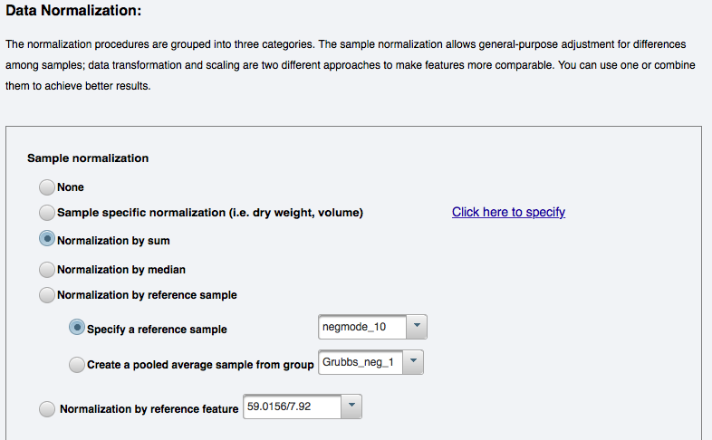

Slide 10
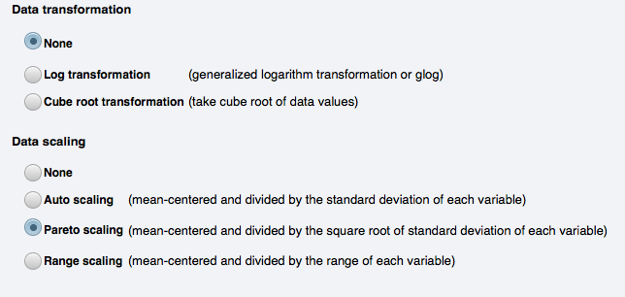

Data options before stats analysis

Slide 11
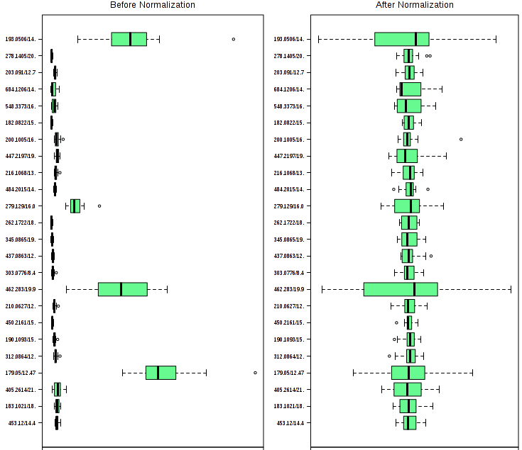

Slide 12
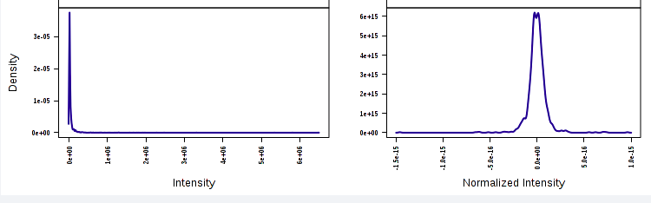

Effect of normalization, mean centering and Pareto scaling

Slide 13
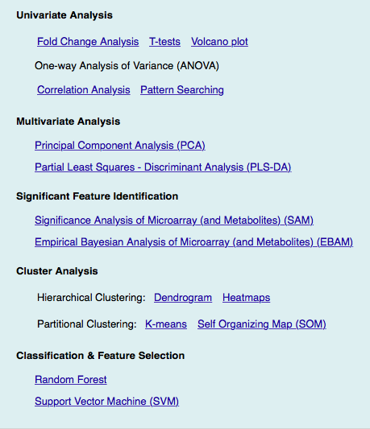
Statistical methods available to process the data on MetaboAnalyst
Today we’ll focus on univariate analysis (Volcano plots) and multivariate analysis (PCA and PLS-DA)

Slide 14
Univariate analysis – Volcano plot
This is a useful measure
The data points represent comparisons made one metabolite at a time
The plot identifies metabolites with p-values <0.01 and a fold change >1.5

Slide 15
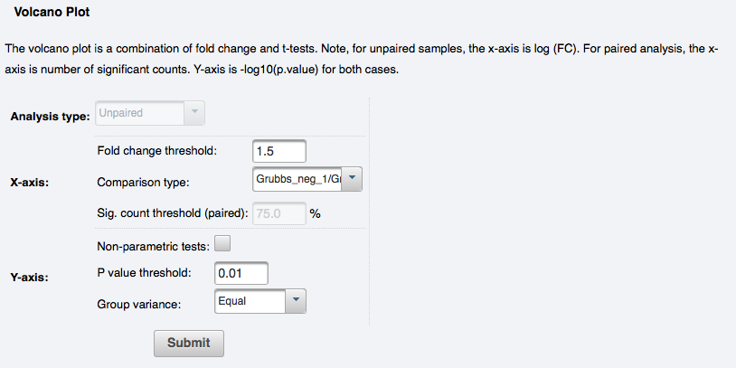
Volcano plot set up

Slide 16
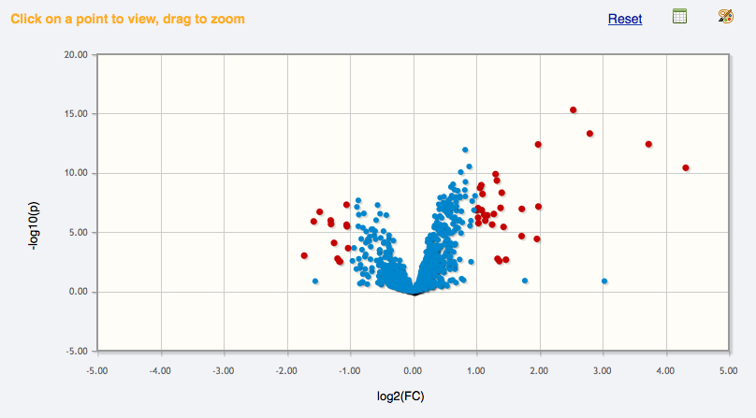
Volcano plot with fold change=1.5 and p <0.01

Slide 17
Multivariate Analysis
In this type of analysis, principal components are identified.
Contributions from all the metabolites to each principal component are calculated, reducing >1000 values to one number for each component
When this done in an unsupervised way, the group information is added after principal component analysis (PCA)
Partial least squares discriminant analysis (PLS-DA) is a supervised procedure and group information is included in the analysis

Slide 18
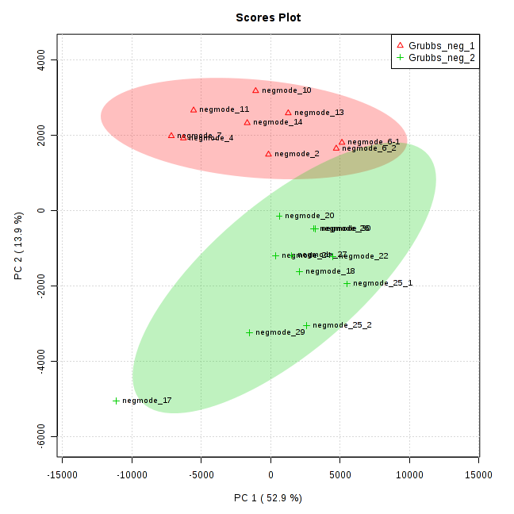
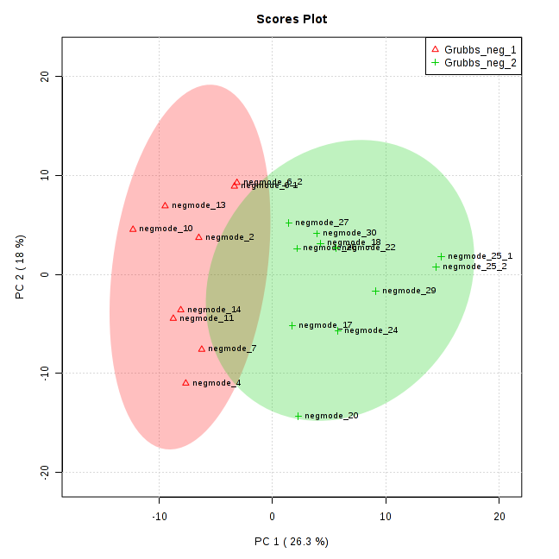
Effect of normalization to TIC on PCA plot
No normalization
With normalization

Slide 19
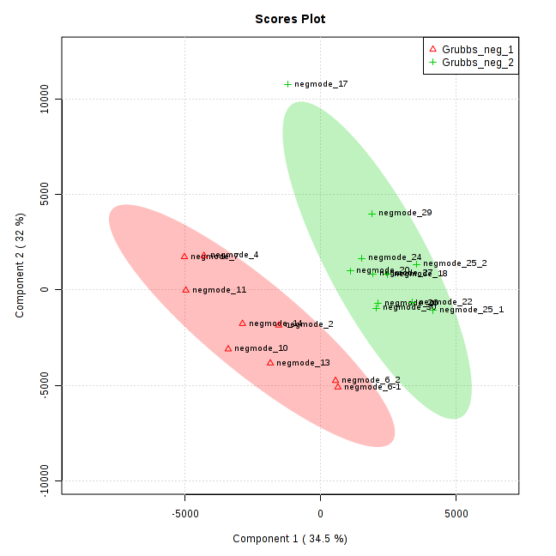
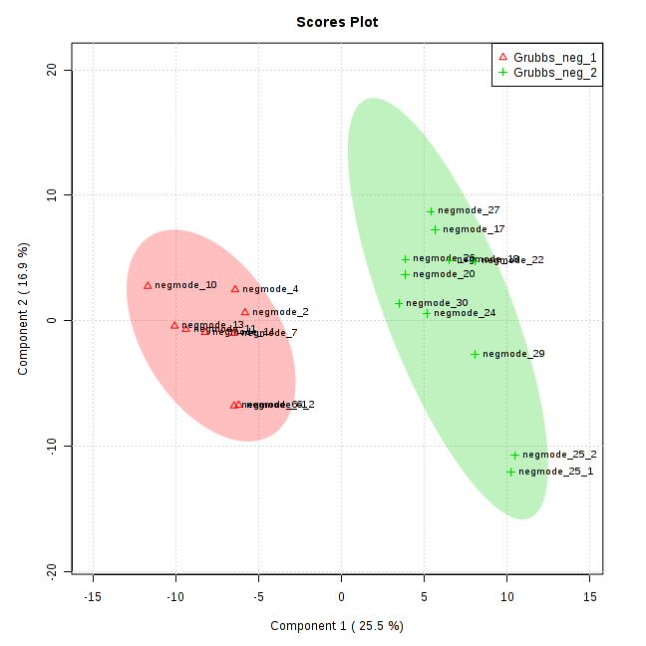
Effect of normalization to TIC on PLS-DA plot
No normalization
With normalization

Slide 20
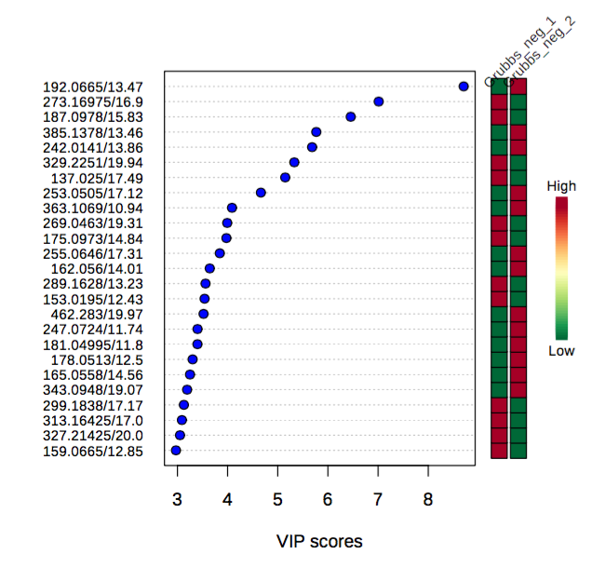
From download file – plsda_vip.csv file

Slide 21
Summary
MetaboAnalyst enables online, statistical analysis of metabolomics data
  Both univariate and multivariate analysis
  Can process both LC-MS and NMR data
  Has many other tools including pathway analysis
Ions identified as being statistically significantly changes can now be validated or mapped to known or unknown pathways
Notes:
Critical point is that validation and identification are very expensive, so it’s important to heavily filter ion candidates before proceeding.

